Slide 1













Protein Function Prediction
via
Multimodal LLM
Bridging Sequence and Function with ESM-2 and Phi-2

Slide 2

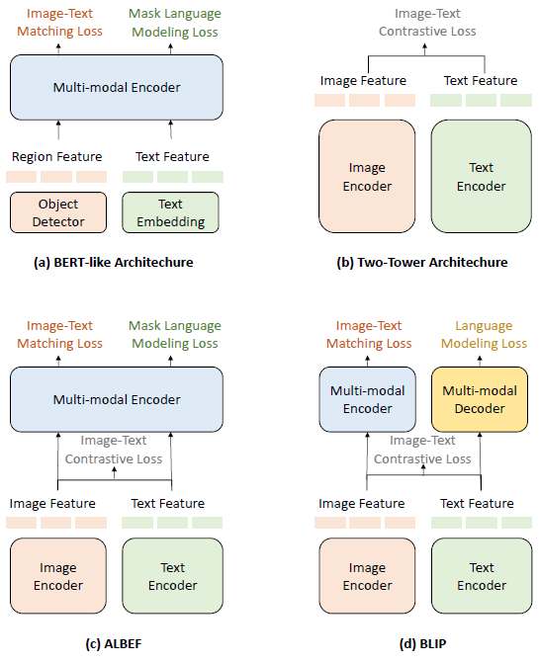
Origin of idea
Inspired by Vision-Language Pretraining & BLIP Architecture
  Inspiration from BLIP (Bootstrapping Language-Image Pre-training):
      Image Encoder + Text Encoder → Multimodal Encoder
      Contrastive learning for image-text alignment
      Decoder for image-to-text generation (captioning)
  For Protein-Specific Adaptation:
      Replace Image Encoder → ESM-2 Protein Encoder
      Replace Text Encoder → Phi-2 Language Model
      Projection network as alignment module (like Q-Former)
      Multi-task objective: LM loss + Alignment + Contrastive
Chen, Hong, et al. "Multi-Modal Generative AI: Multi-modal LLM, Diffusion and Beyond." arXiv preprint arXiv:2409.14993 (2024)

Slide 3
Predict protein function descriptions from protein sequences
Goal
Input: MKTIIALSYIFCLVFA... (protein sequence)
Output: "This protein functions as a membrane transporter involved in glucose uptake. It contains 12 transmembrane domains and is primarily expressed in muscle tissue."
Project Overview
Multimodal architecture combining protein language models with causal LLMs
Approach
10,000 manually reviewed human proteins from UniProt (Swiss-Prot)
Split: 80% train / 10% validation / 10% test
Dataset

Slide 4
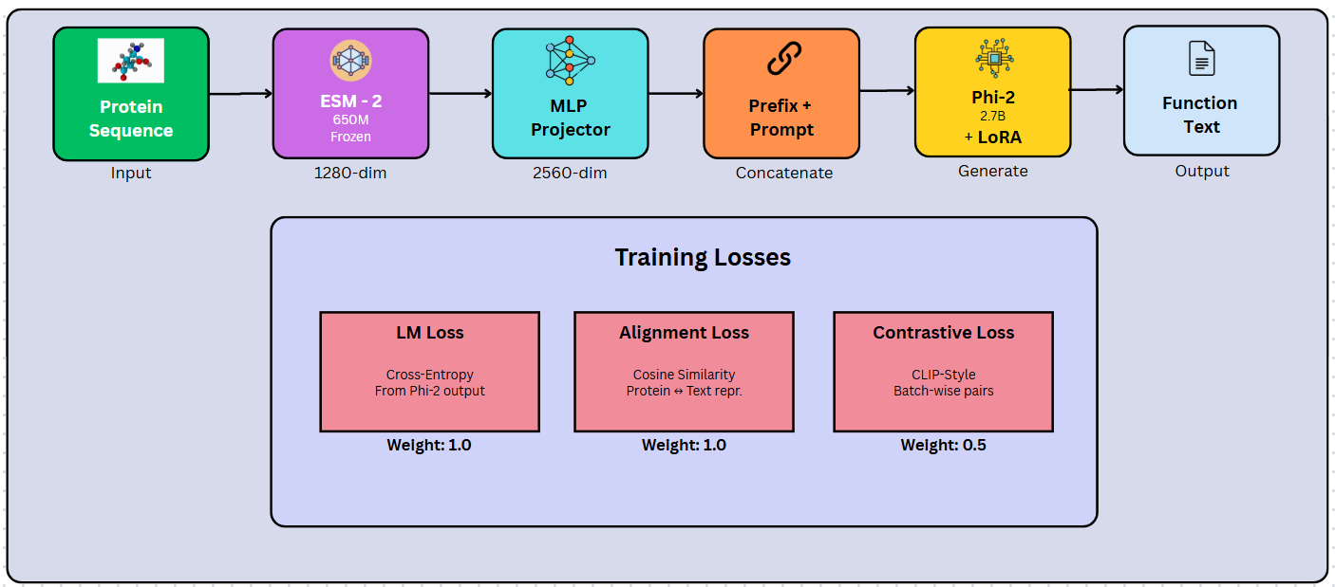
Overall Architecture

Slide 5
Core Components
Protein Encoder:
ESM-2 (Meta AI)
(frozen)
Projection Network: Trainable MLP
Language Model:
Phi-2 (Microsoft Research) (LoRA fine-tuned)
Produces contextualized embeddings from sequences
  Maps 1280-dim ESM → 2560-dim LLM space
  Architecture: Linear(1280→2048) → GELU → Linear(2048→2560)
  2.7B parameter causal LM from Microsoft
  LoRA: r=16, α=32 on q_proj and v_proj layer

Slide 6
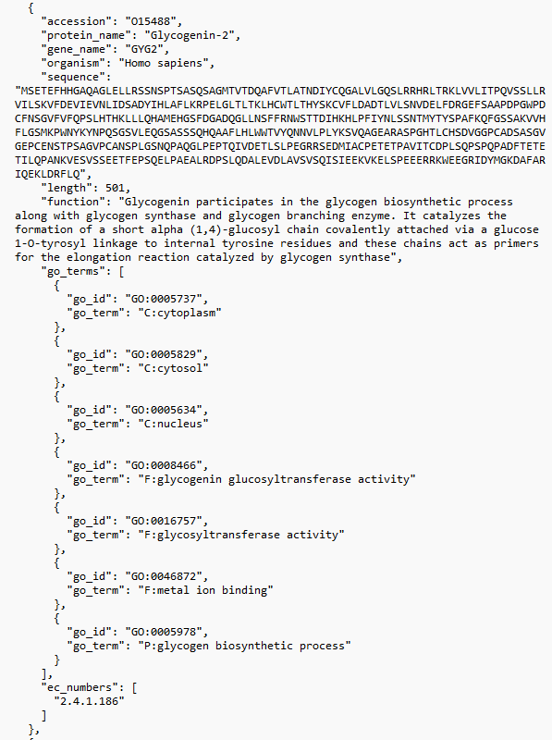
Data Preparation
UniProt Data Fetching
  High-quality protein data is fetched using UniProt's REST API
  Targeting Swiss-Prot reviewed entries from human proteins (organism_id:9606)
  Metadata includes:
      Core data: accession IDs, protein names, gene names, amino acid sequences
      Functional annotations: detailed function descriptions
      Ontology terms: GO (Gene Ontology) terms and EC (Enzyme Commission) numbers
Pre-processing
  Function text undergoes cleaning:
      to remove reference citations
      normalize whitespace
      exclude entries with very small function text length.
  Processed dataset is split into train (80%), validation (10%), and test (10%) sets, with all splits saved as JSON files containing sequence, function, and metadata for each protein.

Slide 7
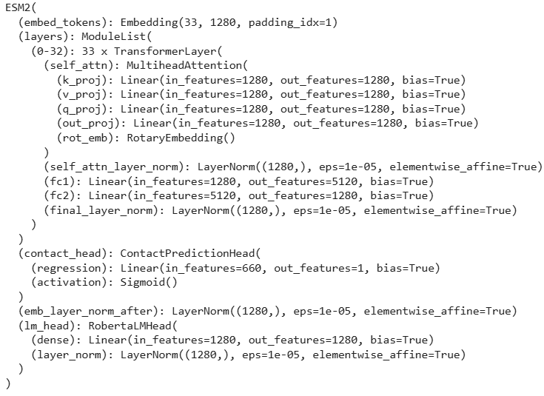
Embedding Generation
  The embedding generation uses Meta's ESM-2 (650M parameter variant) protein language model to create rich representations.
  Proteins are processed in batches of 8, extracting representations from layer 33 (the final layer).
  For each protein, it generates a compact global embedding via mean pooling; 1280-dimensional.

Slide 8
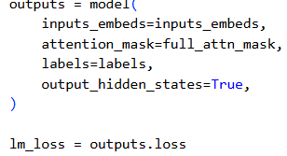
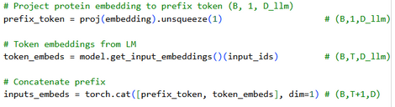
  Protein Encoding
  Projection to LLM Space
  Sequence → ESM-2 → global embedding (1280-dim)
  Mean pooling across residue embeddings
  Frozen encoder preserves pretrained knowledge
  Embedding → Projection MLP → prefix token (2560-dim)
  Two-layer MLP with GELU activation
  Aligns protein and text modalities
Forward
Pass
Details
  Input Construction
  Generation & Loss Computation
  Concatenate [prefix_token | text_token_embeddings]
  Text tokens from prompt: [PROTEIN] LENGTH: ... FUNCTION:
  Phi-2 processes combined sequence
  Extract text representation from last hidden layer
  Normalize protein and text representations
  Compute all three loss components (LM + Alignment + Contrastive)
  Attention mask extension: The prefix token always gets attention (mask=1), while padding tokens get mask=0.
  Labels: ignore prefix (-100), predict function tokens

Slide 9

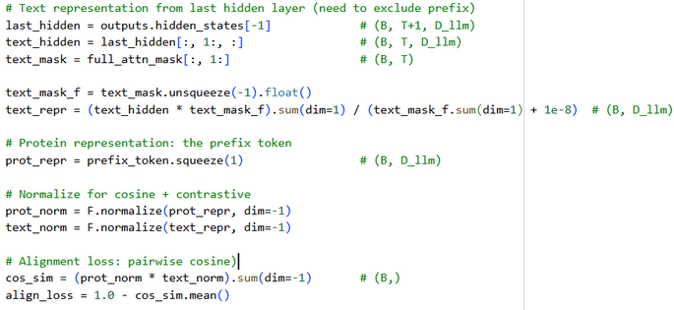
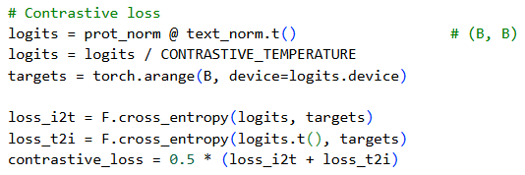
Training Objective:
Multi-Task Loss
Total Loss = LM Loss + 1.0 × Alignment + 0.5 × Contrastive
Language Modeling Loss
      Standard next-token prediction loss
      Teaches the model: "Given this protein embedding and prompt, generate biologically accurate function descriptions."
Alignment Loss (weight: 1, not scaled)
      Cosine similarity between protein and text representations
      Loss = 1 - mean(cos_sim(protein_emb, text_emb))
Contrastive Loss (weight: 0.5)
      CLIP-style symmetric cross-entropy
      Temperature: 0.07 for stable gradients

Slide 10
  Training Configuration
Hyperparameters
Optimization Strategy
Training and Inference Prompt
  Batch size: 16
      ~500 batches/epoch
      Allows contrastive loss to work
      Fits in GPU memory with mixed precision
  Learning rate: 5e-4 with linear warmup
      Warmup: 10% of total steps (gradual learning rate increase)
      Prevents unstable gradients in early training
  Epochs: 10
  Max sequence length: 384 tokens
      Covers prompt + function description
  Gradient clipping: max_norm=1.0
      Prevents exploding gradients
  AdamW optimizer (weight decay for regularization)
  Mixed precision training (FP16)
      2x faster, 50% less memory
      Gradient scaler prevents underflow
  Both model + projector parameters optimized jointly
[PROTEIN]
LENGTH: {sequence_length}
SEQUENCE: {sequence}
[/PROTEIN]
FUNCTION:
{predicted_or_target_function}
Benefits:
  Provides structural context to the LM
  Mirrors evaluation-time behavior
  Enables length-aware generation
Hardware: CUDA GPU (Google Colab)

Slide 11
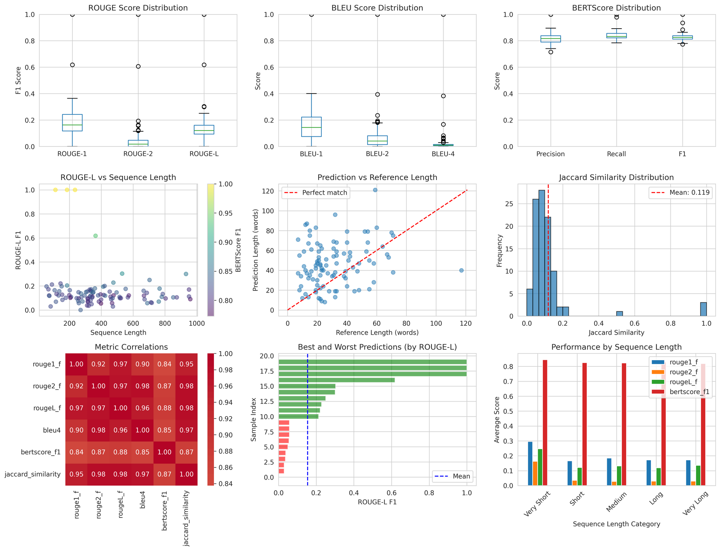
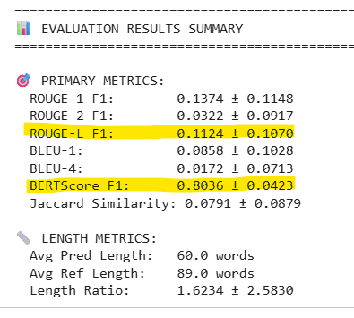
Results Analysis
Key Findings
  Model excels at capturing biological meaning (high BERTScore)
  Predictions are semantically accurate but use different terminology
  Lower ROUGE/BLEU reflects scientific paraphrasing, not poor quality

Slide 12
Sample Predictions
================================================================================
📝 QUALITATIVE ANALYSIS - SAMPLE PREDICTIONS
================================================================================
🏆 TOP 3 PREDICTIONS (by ROUGE-L):
--------------------------------------------------------------------------------
1. Sample 26 | P01714 | ROUGE-L: 1.0000
Protein: Immunoglobulin lambda variable 3-19
Ground Truth: V region of the variable domain of immunoglobulin light chains that participates in the antigen recognition (PubMed:24600447). Immunoglobulins, also known as antibodies, are membrane-bound or secreted glycoproteins produced by B lymphocytes. In the recognition phase of humoral immunity, the membrane-bound immunoglobulins serve as receptors which, upon binding of a specific antigen, trigger the clonal expansion and differentiation of B lymphocytes into immunoglobulins-secreting plasma cells.
Prediction: V region of the variable domain of immunoglobulin light chains that participates in the antigen recognition (PubMed:24600447). Immunoglobulins, also known as antibodies, are membrane-bound or secreted glycoproteins produced by B lymphocytes. In the recognition phase of humoral immunity, the membrane-bound immunoglobulins serve as receptors which, upon binding of a specific antigen, trigger the clonal expansion and differentiation of B lymphocytes into immunoglobulins-secreting plasma cells.
2. Sample 27 | P04808 | ROUGE-L: 1.0000
Protein: Prorelaxin H1
Ground Truth: Relaxin is an ovarian hormone that acts with estrogen to produce dilatation of the birth canal in many mammals. May be involved in remodeling of connective tissues during pregnancy, promoting growth of pubic ligaments and ripening of the cervix
Prediction: Relaxin is an ovarian hormone that acts with estrogen to produce dilatation of the birth canal in many mammals. May be involved in remodeling of connective tissues during pregnancy, promoting growth of pubic ligaments and ripening of the cervix
3. Sample 29 | P09630 | ROUGE-L: 1.0000
Protein: Homeobox protein Hox-C6
Ground Truth: Sequence-specific transcription factor which is part of a developmental regulatory system that provides cells with specific positional identities on the anterior-posterior axis
Prediction: Sequence-specific transcription factor which is part of a developmental regulatory system that provides cells with specific positional identities on the anterior-posterior axis
⚠️ BOTTOM 3 PREDICTIONS (by ROUGE-L):
--------------------------------------------------------------------------------
1. Sample 28 | P09093 | ROUGE-L: 0.0000
Protein: Chymotrypsin-like elastase family member 3A
Ground Truth: Efficient protease with alanine specificity but only little elastolytic activity
Prediction: Important role in determination of the surface properties of the casein micelles
2. Sample 84 | Q6ZS72 | ROUGE-L: 0.0294
Protein: Protein PEAK3
Ground Truth: Probable catalytically inactive kinase (Probable). Interacts with CRK-II and antagonizes CRK-II-signaling. Prevents the formation of CRK-II-dependent membrane ruffling and lamellipodia-like extensions (PubMed:31311869)
Prediction: Transcription factor that binds to DNA at the consensus sequence 5-ACCAAAG-3 (By similarity). Acts as a transcriptional activator (By similarity). Binds cooperatively with POU3F2/BRN2 or POU3F1/ERR17 to gene promoters, which enhances transcriptional activation (By similarity).
3. Sample 98 | Q8IVN3 | ROUGE-L: 0.0299
Protein: Musculoskeletal embryonic nuclear protein 1
Ground Truth: Required for chondrocyte development and proliferation. Plays a role in myoblast differentiation and fusion. Modulates skeletal muscle extracellular matrix composition.
Prediction: Accessory subunit of the mitochondrial membrane respiratory chain NADH dehydrogenase (Complex I), that is believed not to be involved in catalysis. Complex I functions in the transfer of electrons from NADH to the respiratory chain. The immediate electron acceptor for the enzyme is believed to be ubiquinone

Slide 13
Key Innovations
  Frozen Encoder + Lightweight Projection
      Preserves ESM-2's powerful representations
      Only 8.4M trainable parameters in projection
  Multi-Task Training Objective
      Alignment ensures semantic correspondence
      Contrastive learning improves discriminability
  Prefix-Based Integration
      Clean separation of protein and text modalities
      Enables flexible generation at inference
  Efficient Fine-Tuning with LoRA
      Reduces trainable parameters by 99%+
      Maintains generation quality

Slide 14

Future Improvements
  Expand training data to incorporate rare protein families
  Implement confidence scoring for predictions
  Architecture upgrade: to handle long sequences; multi-domain proteins

Slide 15

References
  Chen, Hong, et al. "Multi-Modal Generative AI: Multi-modal LLM, Diffusion and Beyond." arXiv preprint arXiv:2409.14993 (2024)
  Lin, Z., et al. (2022). "Language models of protein sequences at the scale of evolution." bioRxiv. Meta AI.
  Microsoft Research (2023). "Phi-2: The surprising power of small language models." Microsoft.
  Li, J., et al. (2022). "BLIP: Bootstrapping Language-Image Pre-training for Unified Vision-Language Understanding and Generation." ICML.
  Wang, Lei, et al. "A Comprehensive Review of Protein Language Models." arXiv preprint arXiv:2502.06881 (2025)

Slide 16
Thank you!
Presented by:
Sridipta Roy (roy.sr@northeastern.edu)
GitHub Repo:
https://github.com/Sridipta-Roy/Protein-Function-Prediction

